Slide 1



myTaxiService
Function Points Document
(FPD)
Computer Science and Engineering (CSE)
Software Engineering 2 Project
Year 2015/16
Background Music:
Hungarian Rhapsody no.2 - F. Liszt
SE2 – Andrea Martino, Francesco Marchesani
POLITECNICO DI MILANO

Slide 2

Purpose
SE2 – Andrea Martino, Francesco Marchesani
This Function Points Document (FPD) follows the method invented in 1975 by Allan Albrecht (IBM) in order to give a good cost approximation of myTaxiService project. Thus, we will focus on the level of abstraction of the functionalities of the service.
RASD
Deadline: 06/11/2015
Final Presentation
TBA
ITPD
Deadline: 21/01/2016
Inspection Document
Deadline: 05/01/2016
Design Document
Deadline: 04/12/2015
Function Points
Deadline: 30/01/2016
POLITECNICO DI MILANO

Slide 3
Function Points Macro-categories
SE2 – Andrea Martino, Francesco Marchesani
Internal Logical File (ILF): homogeneous set of data used and managed by the application.
External Interface File (EIF): homogeneous set of data used by the application but generated and maintained by other external applications.
External Input: elementary operation to elaborate data coming from the external environment (from users).
External Output: elementary operation that generates data for the external environment. It usually includes the elaboration and a proper representation of data from logic files.
External Inquiry: elementary operation that involves input and output (e.g. specific requests of the user in order to visualize his/her information). This category does not implies significant elaboration of data from logic files.
POLITECNICO DI MILANO

Slide 4
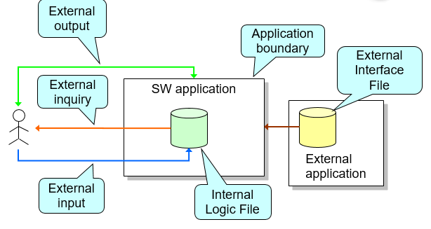
FPs in a nutshell
SE2 – Andrea Martino, Francesco Marchesani
POLITECNICO DI MILANO

Slide 5
FPs Weights Table
SE2 – Andrea Martino, Francesco Marchesani
Function types N. Inputs N. Outputs N. Inquiry N. ILF N. EIF | Weight
 | Simple 3 4 3 7 5 | Medium 4 5 4 10 7 | Complex 6 7 6 15 10
POLITECNICO DI MILANO

Slide 6
---
SE2 – Andrea Martino, Francesco Marchesani
…
POLITECNICO DI MILANO

Slide 7
---
SE2 – Andrea Martino, Francesco Marchesani
…
POLITECNICO DI MILANO

Slide 8
---
SE2 – Andrea Martino, Francesco Marchesani
…
POLITECNICO DI MILANO

Slide 9
---
SE2 – Andrea Martino, Francesco Marchesani
…
POLITECNICO DI MILANO

Slide 10
---
SE2 – Andrea Martino, Francesco Marchesani
…
POLITECNICO DI MILANO

Slide 11
---
SE2 – Andrea Martino, Francesco Marchesani
…
POLITECNICO DI MILANO

Slide 12
---
SE2 – Andrea Martino, Francesco Marchesani
…
POLITECNICO DI MILANO

Slide 13
---
SE2 – Andrea Martino, Francesco Marchesani
…
POLITECNICO DI MILANO

Slide 14
---
SE2 – Andrea Martino, Francesco Marchesani
…
POLITECNICO DI MILANO

Slide 15

Thank you!!!
SE2 – Andrea Martino, Francesco Marchesani
POLITECNICO DI MILANO

